Slide 1
Evaluation of parallelism techniques on embedded multi-core platforms
Lucas Jenß
Mentor: Prof. Dr. B. Schwarz

Slide 2
Outline
Development Platform
Parallelism Techniques
Pipeline Pattern
Single Instruction – Multiple Data (SIMD)
Google Go for parallelism

Slide 3
The Platform
Xilinx Zynq w/ ARM Cortex-A9

Slide 4


Obstacle Detection
Using Laser scanner
Data rate: ~34KB/s
10Hz scanning freq.
240° in 0.36° steps
Currently implemented with Java on Android OS

Slide 5
Lane Guiding Control
Lane Guiding Control using high FPS camera (60 FPS, 752x40px)
Data rate: ~20MB/s
Implemented using C and FPGA modules, on Linux

Slide 7
Current state: mix of different technologies
Java on Android, C/FPGA on Linux
Goals:
technological unification of the platform
parallelization of tasks to improve performance

Slide 8
Parallelism Techniques
Pipeline pattern

Slide 9
Parallelism
Finding exploitable concurrency
Finding sub-problems that can safely execute at the same time

Slide 10

Pipeline Pattern

Slide 11
Pipeline Pattern
Analogy: Assembly line (e.g. for a Car)

Slide 12
Pipeline Pattern
Car #1

Slide 13
Pipeline Pattern
Car #2
Car #1

Slide 14
Pipeline Pattern
Car #3
Car #2
Car #1

Slide 15
Pipeline Pattern
All workers
are busy at all times
work on different tasks on different cars
yet all tasks are directly related
Car #3
Car #2
Car #1

Slide 16
Pipeline Pattern
Assembly line has
Workers
Cars, or some other items
Transport mechanism for the items

Slide 17
Pipeline Pattern
For the pipeline pattern, this translates to
Threads (instead of Workers)
Data (instead of Cars)
Communication channel (instead of the transport mechanism)

Slide 18
Pipeline Stage Pseudo code
while(more elements) { receive element from previous stage perform operation on element send element to the next stage }

Slide 19
Pipeline Pattern Pseudo code
while(more elements) { receive element from previous stage perform operation on element send element to the next stage }

Slide 20
Pipeline Pattern Pseudo code
while(more elements) { receive element from previous stage perform operation on element send element to the next stage }

Slide 21
Pipeline Pattern Pseudo code
while(more elements) { receive element from previous stage perform operation on element send element to the next stage }

Slide 22
Pipeline Pattern
Theoretically:
Parallelization of any computing problem
Because the pipeline “transforms” linearity into parallelism

Slide 23
Pipeline Pattern
In practice:
Communication between stages is the bottleneck
In order to achieve good performance:
Communication time Stage operation time
Small difference between stage operation times

Slide 24
Outline
Development Platform
Parallelism Techniques
Pipeline Pattern
Single Instruction – Multiple Data (SIMD)
Google Go for parallelism

Slide 25
Single Instruction – Multiple Data
Using the ARM NEON engine

Slide 26
Single Instruction - Multiple Data
Exploits data-level parallelism
Operations repeatedly applied to independent data

Slide 27
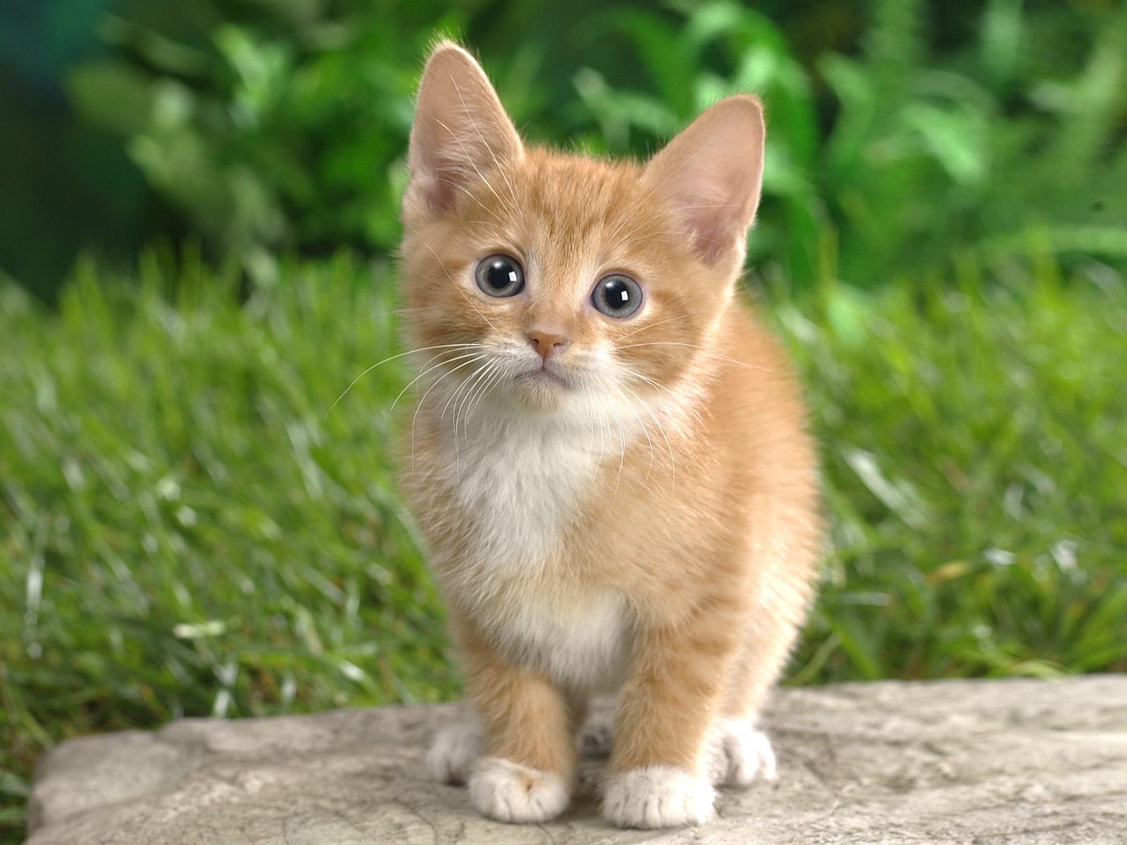

Single Instruction - Multiple Data
Exploits data-level parallelism
Operations repeatedly applied to independent data

Slide 28
Single Instruction – Single data Converting an image to gray scale
Notes:
TODO:
Show each step

Slide 29
Single Instruction – Single data Converting an image to gray scale
void rgb2grey(uint8_t *dest, uint8_t *src, int pixels) { for(int i=0; i < pixels; i++) { uint8_t r = *src++; uint8_t g = *src++; uint8_t b = *src++; uint16_t y = r * 77 + g * 151 + b * 28; *dest++ = (y >> 8); } }
Notes:
TODO:
Multiply
Write back

Slide 30
Single Instruction – Single data Converting an image to gray scale
void rgb2grey(uint8_t *dest, uint8_t *src, int pixels) { for(int i=0; i < pixels; i++) { uint8_t r = *src++; uint8_t g = *src++; uint8_t b = *src++; uint16_t y = r * 77 + g * 151 + b * 28; *dest++ = (y >> 8); } }
Notes:
TODO:
Multiply
Write back

Slide 31
Single Instruction – Single data Converting an image to gray scale
void rgb2grey(uint8_t *dest, uint8_t *src, int pixels) { for(int i=0; i < pixels; i++) { uint8_t r = *src++; uint8_t g = *src++; uint8_t b = *src++; uint16_t y = r * 77 + g * 151 + b * 28; *dest++ = (y >> 8); } }
Notes:
TODO:
Multiply
Write back

Slide 32
Single Instruction – Single data Converting an image to gray scale
void rgb2grey(uint8_t *dest, uint8_t *src, int pixels) { for(int i=0; i < pixels; i++) { uint8_t r = *src++; uint8_t g = *src++; uint8_t b = *src++; uint16_t y = r * 77 + g * 151 + b * 28; *dest++ = (y >> 8); } }
Notes:
TODO:
Multiply
Write back

Slide 33
Single Instruction – Multiple data Converting an image to gray scale
ARM NEON uses special registers
Separate from CPU registers
“Q”(uad) and “D”(ouble), 128-bit and 64-bit wide
Multiple elements per register
e.g. 8 * 8 bit in “D” register

Slide 34
Single Instruction – Multiple data Converting an image to gray scale
Steps to use SIMD:
Load data into NEON registers
Apply operations
Write data back to memory

Slide 35
Single Instruction – Multiple data Load data into NEON registers

Slide 36
Single Instruction – Multiple data Apply operations
multiply
multiply, accumulate

Slide 37
Single Instruction – Multiple data Converting to gray scale
for(int i=0; i < pixels; i += FACTOR) { uint8x8x3_t rgb = vld3_u8(src); uint16x8_t acc; acc = vmull_u8(rgb.val[0], rcoeff); acc = vmlal_u8(acc, rgb.val[1], gcoeff); acc = vmlal_u8(acc, rgb.val[2], bcoeff); uint8x8_t result = vshrn_n_u16(acc, 8); vst1_u8(dest, result); src += FACTOR; dest += FACTOR; }

Slide 38
Single Instruction – Multiple data Converting to gray scale
for(int i=0; i < pixels; i += FACTOR) { uint8x8x3_t rgb = vld3_u8(src); uint16x8_t acc; acc = vmull_u8(rgb.val[0], rcoeff); acc = vmlal_u8(acc, rgb.val[1], gcoeff); acc = vmlal_u8(acc, rgb.val[2], bcoeff); uint8x8_t result = vshrn_n_u16(acc, 8); vst1_u8(dest, result); src += FACTOR; dest += FACTOR; }
Load (3 Interleaved)

Slide 39
Single Instruction – Multiple data Converting to gray scale
for(int i=0; i < pixels; i += FACTOR) { uint8x8x3_t rgb = vld3_u8(src); uint16x8_t acc; acc = vmull_u8(rgb.val[0], rcoeff); acc = vmlal_u8(acc, rgb.val[1], gcoeff); acc = vmlal_u8(acc, rgb.val[2], bcoeff); uint8x8_t result = vshrn_n_u16(acc, 8); vst1_u8(dest, result); src += FACTOR; dest += FACTOR; }
uint8x8x3_t
Type
Elements per Register
# of Registers

Slide 40
Single Instruction – Multiple data Converting to gray scale
for(int i=0; i < pixels; i += FACTOR) { uint8x8x3_t rgb = vld3_u8(src); uint16x8_t acc; acc = vmull_u8(rgb.val[0], rcoeff); acc = vmlal_u8(acc, rgb.val[1], gcoeff); acc = vmlal_u8(acc, rgb.val[2], bcoeff); uint8x8_t result = vshrn_n_u16(acc, 8); vst1_u8(dest, result); src += FACTOR; dest += FACTOR; }
Loads 8bit * 8 * 3 = 192 bit = 24 byte!

Slide 41
Single Instruction – Multiple data Converting to gray scale
for(int i=0; i < pixels; i += FACTOR) { uint8x8x3_t rgb = vld3_u8(src); uint16x8_t acc; acc = vmull_u8(rgb.val[0], rcoeff); acc = vmlal_u8(acc, rgb.val[1], gcoeff); acc = vmlal_u8(acc, rgb.val[2], bcoeff); uint8x8_t result = vshrn_n_u16(acc, 8); vst1_u8(dest, result); src += FACTOR; dest += FACTOR; }
Apply
operations

Slide 42
Single Instruction – Multiple data Converting to gray scale
for(int i=0; i < pixels; i += FACTOR) { uint8x8x3_t rgb = vld3_u8(src); uint16x8_t acc; acc = vmull_u8(rgb.val[0], rcoeff); acc = vmlal_u8(acc, rgb.val[1], gcoeff); acc = vmlal_u8(acc, rgb.val[2], bcoeff); uint8x8_t result = vshrn_n_u16(acc, 8); vst1_u8(dest, result); src += FACTOR; dest += FACTOR; }
Write back to memory

Slide 43
Single Instruction – Multiple data Performance
Native C-Version
16 Instructions / Pixel
SIMD Version:
15 Instructions / 8 Pixels
~2 Instructions / Pixel

Slide 44
Google Go
TODO

Slide 45
Language Specification

Slide 46
Evaluation
TODO

Slide 47
The End
Any questions?

